Slide 1
COMP3375 – Software Quality Assurance Group Assignment PowerPoint Presentation

Slide 2
Group Members / Development Team
Beaumont Hackett – Team Leader / Front-end Developer
Tabari Rudder-Fields – Lead Backend Developer
Daniel Braithwaite – Tester / Backend Developer
William Brace – Researcher / Documenter
Bradley Harris – Researcher / Documenter

Slide 3
Introduction
Healthcare is an integral part of every society, with hospitals being the centre of such activity. Thus, it is imperative that the healthcare process of a hospital is as nice an experience as possible for everyone involved. As a result, our team was tasked with enhancing the healthcare experience for patients attending the hospital by improving how they familiarise themselves with the department and/or ward which they are being seen or are staying in.
This solution took the form of software through an interactive website which provides all the information a patient moving from the accident and emergency department to a ward in the hospital would need.

Slide 4
Introduction CONT’D
Our team used the rapid application development model in order to develop this application in order to provide for measurable progress of development and easy modification through compartmentalisation of system components. We created a user-friendly interface by keeping the end user in mind every step of the way. As far as the content of the site, it contains general information about the department/ward to anyone after they login with a guest ID and password.
On the administrative side, administrative personnel can long on through entering their admin ID and password which must be approved before they can view the system. While logged in, they can manipulate certain information that is contained on the site such as updating the frequently asked question page by asking new questions.

Slide 5
Introduction CONT’DW
One of the main areas our team focussed on was the quality of the application, and thus thorough testing played a large role in the development process. We utilised unit, integration and alpha testing to test the application as thoroughly as possible in order to detect faults which were rectified in the next software build.
In summation, given the importance of healthcare and its requirement for excellence we were tasked with this project and have done everything in our power to ensure it functions as it is supposed to and meets the needs of the patients.

Slide 6
Testing
To fully test the entirety of the application, both frontend and backend, it was decided to test the application on three (3) distinct levels.
Unit Testing using Boundary Value Analysis (BVA) and Equivalence Class Partitioning (ECP) to ensure that software pieces in isolation function properly.
Integration Testing to check the interactions between software components to reveal any functional errors.
Alpha Testing to simulate the regular operation of the system to ensure that it could execute uninterrupted successfully to achieve all goals outlined.

Slide 7
Unit testing Cases
Test Scenario 1
These series of tests were used to test the unit function that stores the Guest and Child Name of a Guest User. Both ECP and BVA were test various data lengths entered into text boxes.
Scenario 1-1 was to confirm the unit function would store strings as long as one character. The function executed successfully with strings that were 3-4 characters in length.
Scenario 1-2 was to confirm if the unit function would not allow empty fields. The function refused to accept empty fields, prompting the user to enter values.
Scenario 1-3 was to confirm a valid amount for both fields. The minimum and maximum values for both fields is 1 and 20 respectively. Both fields were filled with 10 characters which were accepted.

Slide 8
Unit Testing Cases cont’d
Scenario 1-4 was to confirm that 1 character was a valid amount for both fields. The function executed successfully.
Scenario 1- 5 was to confirm that 2 characters was a valid amount for both fields. The function executed successfully.
Scenario 1- 6 was to confirm that the limit of 20 characters is a valid amount for both fields. The function executed successfully.
Scenario 1 – 7 was to confirm that 19 characters, just below the limit is a valid amount for both fields. The function executed successfully.
These test cases had a high adequacy since they were able to satisfy BVA conditions in just five test cases.

Slide 9
Unit testing Cases CONT’D
Test Scenario 1
Let Guest Name = G and Child Name = C
Equivalence Class Partitioning (Test Scenario 1-1 to 1-2)
G = 0, C = 0 satisfies G < 1 and C < 1
G = 3, C = 3 satisfies G >= 1 and C >= 1

Slide 10
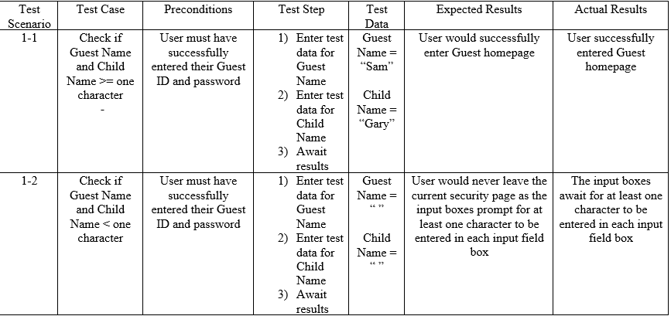
Unit Testing Cases cont’d - ECP

Slide 11
Unit testing Cases CONT’D
Test Scenario 1
Let Guest Name = G and Child Name = C
Boundary Value Analysis (Test Scenario 1-3 to 1-7)
G = 10, C = 10 satisfies nominal values for G and C
G = 1, C =1 satisfies minimum for G and C
G = 2, C = 2 satisfies just above minimum for G and C
G = 20, C = 20 satisfies maximum for G and C
G = 19, C = 19 satisfies just below maximum for G and C

Slide 12
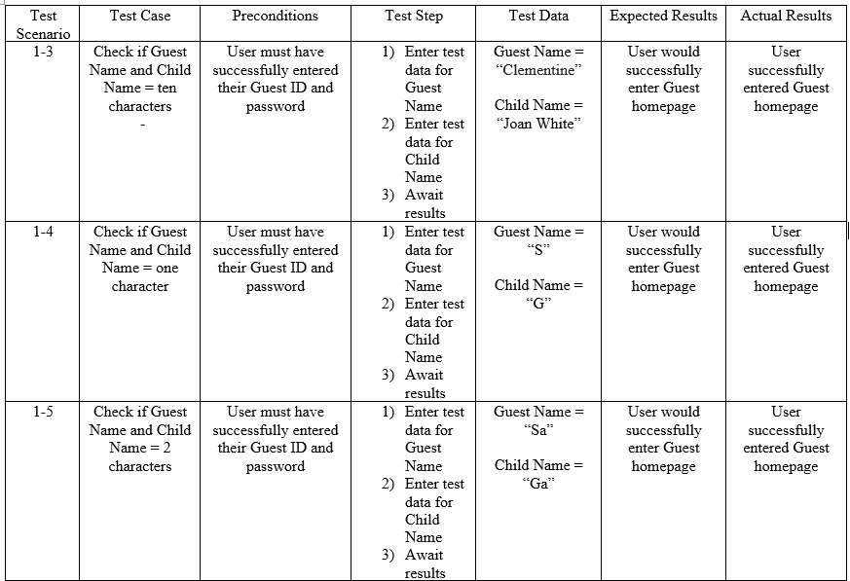
Unit Testing Cases cont’d - BVA

Slide 13
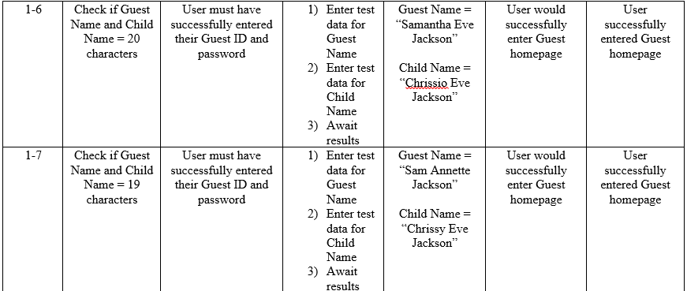
Unit Testing Cases cont’d - BVA

Slide 14
Unit Testing Cases cont’d
Test Scenario 2
This scenario consisted of a series of test cases to confirm that the unit function would only allow a successful login when receiving valid credentials for Admin Name and Password. ECP were used to derive test cases as BVA would not be suitable for Boolean expressions.
Scenario 2-1 was to confirm the functionality that would allow successful access after receiving a valid Admin Name and Password. After the data was entered, the function successfully executed to completion.
Scenario 2-2 was to confirm the functionality that would not allow successful access after receiving an invalid Admin Name and Password. After the data was entered, the function did not allow access to the Admin side of the system.

Slide 15
Unit testing Cases CONT’D
Test Scenario 2
Let A = Admin Name and P = Password
Equivalence Class Partitioning
A = Valid, P = Valid satisfies A = Valid and P = Valid
A = Invalid, P = Invalid satisfies A = Invalid and P = Invalid

Slide 16
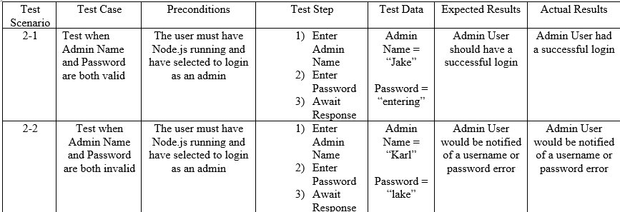
Unit Testing Cases cont’d - ECP

Slide 17
Unit Testing Cases cont’d
Test Scenario 3
This scenario consisted of a series of test cases to confirm that the unit function would only allow a successful login when receiving valid credentials for Guest ID and Password. ECP were used to derive test cases as BVA would not be suitable for Boolean expressions.
Scenario 3-1 was to confirm the functionality that would allow successful access after receiving a valid Guest ID and Password. After the data was entered, the function successfully executed to completion.
Scenario 3-2 was to confirm the functionality that would not allow successful access after receiving an invalid Guest ID and Password. After the data was entered, the function did not allow access to the Admin side of the system.

Slide 18
Unit testing Cases CONT’D
Test Scenario 3
Let G = Guess ID and P = Password
Equivalence Class Partitioning
G = Valid, P = Valid satisfies G = Valid and P = Valid
G = Invalid, P = Invalid satisfies G = Invalid and P = Invalid

Slide 19
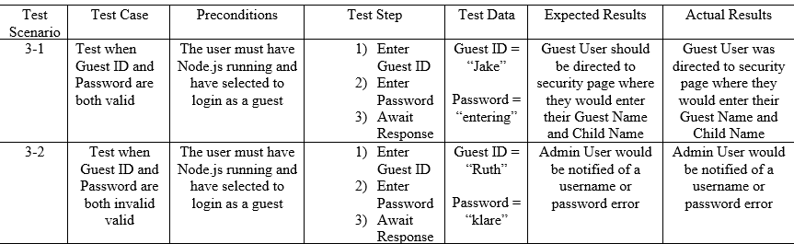
Unit Testing Cases cont’d - ECP

Slide 20
Unit Testing Cases cont’d
Test Scenario 4
This scenario consisted of a series of test cases to confirm that the unit function that checks if a MySQL database has been created or not. In case there is not one, it is then created. ECP was used to derive the following test cases.
Scenario 4-1 was to confirm that the unit function would recognize that a database had already been created. No message displayed so the database was already in place.
Scenario 4-2 was to confirm that the unit function would recognize the lack of a database and then create one. The function notified that a database was created, thus the test was successful.

Slide 21
Unit testing Cases CONT’D
Test Scenario 4
Let D = Database
Equivalence Class Partitioning
D = Created
D = Not Created

Slide 22
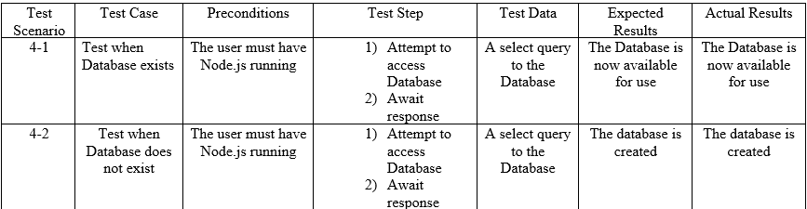
Unit Testing Cases cont’d - ECP

Slide 23
Unit Testing Cases cont’d
Test Scenario 5
This scenario consisted of a series of test cases to confirm that the unit function that checks if an Access Control List and User Log Table have been created or not. In case where neither table was created, the function does so. ECP was used to derive the following test cases.
Scenario 5-1 was to confirm that the unit function would recognize that both tables had already been created. No message displayed so the tables were already in place.
Scenario 5-2 was to confirm that the unit function would recognize the lack of either table and then create both of them. The function notified that the tables were created, thus the test was successful.

Slide 24
Unit testing Cases CONT’D
Test Scenario 5
Let A = Access Control List and L = User Logs Table
Equivalence Class Partitioning
A = Created, L = Created satisfies A = Created and L = Created
G = Not Created, L=Not Created satisfies A = Not Created and
L = Not Created

Slide 25
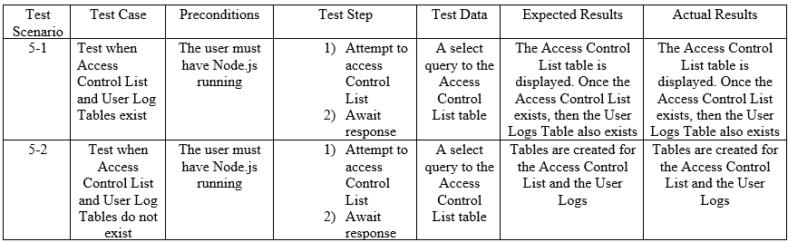
Unit Testing Cases cont’d - ECP

Slide 26
Unit Testing Cases cont’d
Test Scenario 6
This scenario consisted of a series of test cases to confirm that the unit function that checks if a Frequently Answered Questions (FAQs) table had been created or not. If not, the function does so. ECP was used to derive the following test cases.
Scenario 6-1 was to confirm that the unit function would recognize the FAQs table had already been created. No message displayed so the FAQ table was already in place.
Scenario 6-2 was to confirm that the unit function would recognize the lack of the FAQs table and then create the table. The function notified that the table was created, thus the test was successful.

Slide 27
Unit testing Cases CONT’D
Test Scenario 6
Let F = FAQ Table
Equivalence Class Partitioning
F = Created
F = Not Created

Slide 28
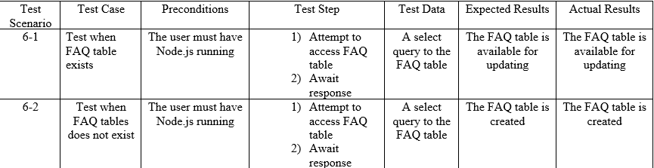
Unit Testing Case cont’d - ECP

Slide 29
Integration testing cases
The following series of test cases were used to analyze each of the main functionality our web application. The three main functionalities are Login process for a Guest, the Login process for an Admin staff member and updating the FAQ table.
Scenario 1-1 and Scenario 1-2 tested the integration between the Database Check Unit Function and the User Access List/User Log unit function during both successful and unsuccessful Admin login attempts. These goals were fulfilled using invalid and valid credentials where the user would be prompted to enter valid credentials and be allowed passage to the Admin Homepage respectively.

Slide 30
Integration testing cases CONt’d
Scenario 2-1 and Scenario 2-2 tested the integration between the Database Check Unit Function and the User Access List/User Log unit function during both successful and unsuccessful Guest login attempts. These goals were fulfilled using invalid and valid credentials where the user would be prompted to enter valid credentials and be allowed passage to the Guest Homepage respectively.
Scenario 3-1 and Scenario 3-2 tested the integration of the functions used when the FAQ table is checked, updated and data is displayed on the page. The goals were to successfully enter a new Question and Answer and be submitted to both the FAQ table and the FAQ simultaneously. This distinguishing tests show that this would be possible whether an FAQ table existed before or not. Since both tests executed successfully, our goals were achieved.

Slide 31
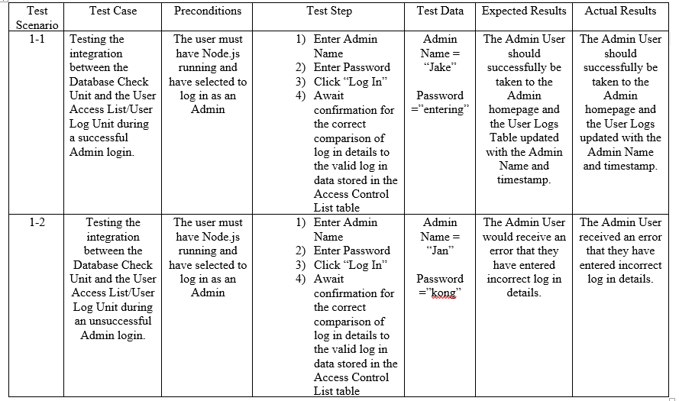
Integration testing cases CONt’d

Slide 32
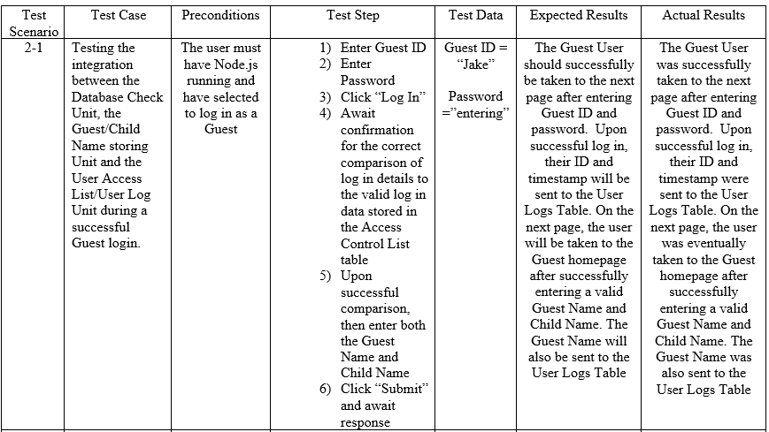
Integration testing cases CONt’d

Slide 33
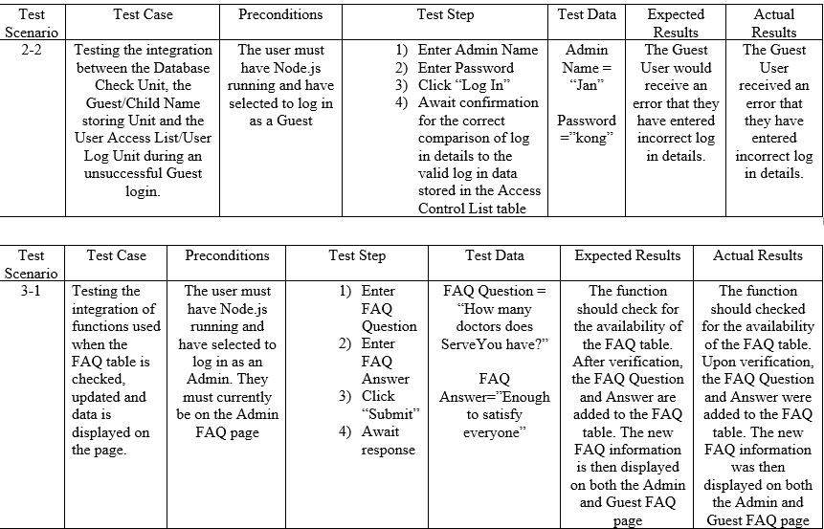
Integration testing cases CONt’d

Slide 34
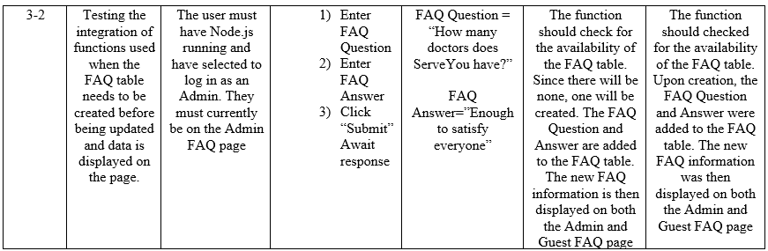
Integration testing cases CONt’d

Slide 35
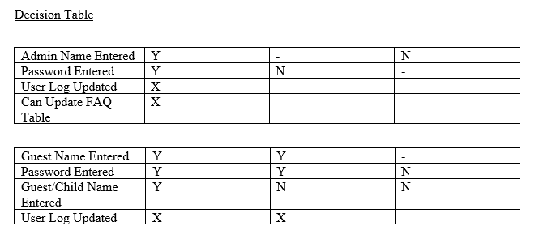
ALPHA Testing cases
A Decision Table was used to give an adequate perspective on how to arrange goals that were highlighted in the requirements of the assignment. Throughout this test case we were able to successfully achieve each goal. Confirmation came in the form of the information being displayed on file as requested.

Slide 36
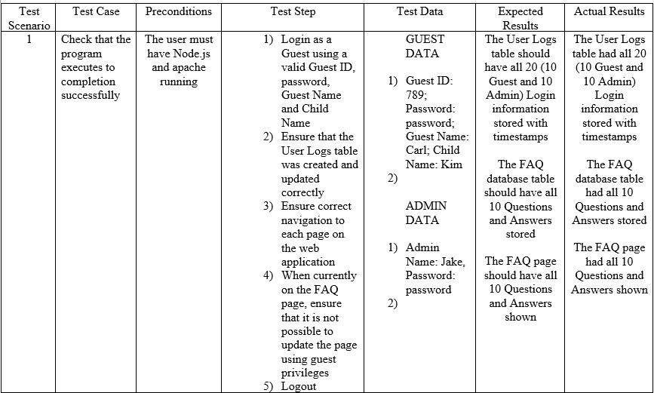
ALPHA Testing cases

Slide 37
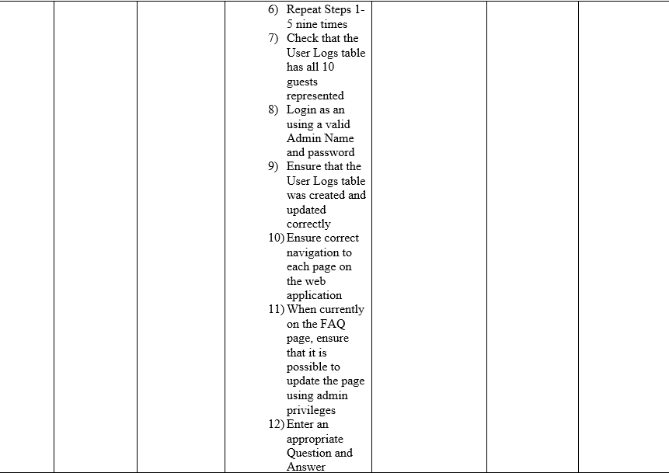
ALPHA Testing cases

Slide 38
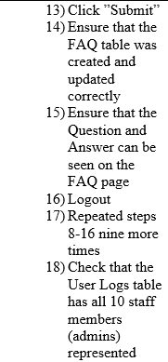
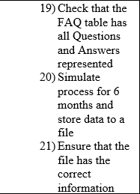
ALPHA Testing cases

Slide 39
Development process model
Our team choose to use the Rapid Application Development (RAD) model to tackle the requirements of this Assignment. This model favors rapid developments of smaller projects, making it ideal for our project whereas the Spiral Process Model would be better suited for larger projects.
RAD allowed us to have flexibility during the design and implementation process where we able to make quick changes to allow the application to continuously adapt to the requirements of the assignment.

Slide 40
Development process model CONT’D
Since this project was on a short deadline RAD was an even more attractive choice. Without the restrictions of the Spiral Model we had a prototype up and working within a few days and we were able to introduce more features and increase the user friendliness with each major update.
Another reason we chose RAD was it allowed us to easily and quickly have a visual aspect of the requirements needed. This visualization allowed us to identify flaws easier, resulting in less flaws that needed to be addressed with each prototype cycle.

Slide 41
RAD Development phases
Requirements Planning (Definition Stage): The first task was to analyze the requirements and develop a business model for this project. We identified what was vital and necessary information and put heavy focus on that. We continued to analyze the other requirements, ensuring every member of the team had a clear understanding of them.
User Design (Design Stage): This stage had the team taking the defined requirements and transforming them into a visual display. Since realistically we were not able to meet with clients for this project, we all at some stage took on the roll as a client by sharing ideas and insights about ways to continuously improve the design. The main focus was on usability, mobile responsiveness and accuracy to requirements.

Slide 42
RAD Development phases CONt’d
Rapid Construction (Development Stage): This stage had the team take the web app prototype and transform it into a working model. Although at this stage changes were still possible, the iterative design phase made it possible to quickly and smoothly finalize the development of this application. This is the phase where testing took place.
Implementation (Deployment Stage): The final tests and checks were done to confirm full functionality before launching the web application fully. Upon completion we had a fully functional application that could use node.js to satisfy the requirements of the assignment.

Slide 43
Maintenance
One the main concerns of the development team after the application is fully launched is the subject of maintaining the application. In this case, maintenance would be keeping the application up to date and tuned to the ever changing world of technology and environment it is operating in.
We are concerning ourselves with Adaptive Maintenance of the application to allow it to adapt to the web application landscape which is in a constant state of flux. We will be taking the proper measures to ensure it goes as smoothly as possible.
A likely cause of maintenance would be future versions of web browsers which may prove incompatible with our application. The app would have to be modified to work with these new web browsers BEFORE they are released.

Slide 44
Software quality recommendations
Software Quality is an extremely important principle whose processes must be applied at many stages during the development cycle, including maintenance.
Software Quality Management (SQM) processes serve the role of ensuring quality by having many different processes, some of which will directly find defects while others show where further evaluation may be needed.
SQM processes include those for quality assurance, verification, validation, reviews and auditing.

Slide 45
Software quality recommendations cont’d
The 1st SQM is the quality assurance process. This process creates a plan which details the quality requirements and specific techniques that will be used to achieve them such as cost and resource management, scheduling and overall management.
The 2nd SQM is Verification and Validation (V&V). These include activities which address the software product quality directly and uses testing techniques to flush out any defects that need to be addressed. They are methods to ensure the software product meets the requirements created (verification) and checks to see whether the product built to match these requirements actually fulfils its intended purpose (validation).

Slide 46
Software quality recommendations cont’d
Improved Reviews and Audits would also improve the software quality approach for the organization. Reviews would determine the adequacy of plans and help keep track of progress. Audits carried out by 3rd parties would give an unbiased look at new builds to check non-conformance levels and produce reports detailing corrective action.
Lastly the organization can improve their approach to software quality by developing a healthy culture which encourages a commitment to quality. If engineers and developers have a focus on quality as they develop, the end product will meet a greater standard. Therefore the developers should follow the code of ethics and professional practice created regulatory bodies such as the IEEE.

Slide 47
conclusion
Upon completion of this project, our team was able to provide a functioning web application that could be used by Accident & Emergency attendees. Our flexible design would allow any attendee to use our application with any type device sufficiently.
No longer will attendees entering the Accident & Emergency department be left in the dark. Now there is simple program that can guide them from the moment of entry up to their temporary stay at ServeYou Hospital.

Slide 48
Conclusion CONT’D
Having used the Rapid Application Development Model, we were able to design and build a functioning application in reasonable time with minimum faults. It is because of the repetitive upgrade to the prototype in each stage that our program increased closer and closer towards perfection, allowing for easier testing with each cycle.
Our focus was more on functionality than imagery & style.

Slide 49
Conclusion CONT’D
Maintenance is just as important as Design and Implementation. We offered our perspective on the best path and importance of adaptive maintenance. It would be pivotal to be able to continual update and maintain a program of this importance.
The medical industry is always updating and improving, which requires that doctors and nurses continue to educate and keep themselves update. Shouldn’t this also apply to our application?

Slide 50
Conclusion CONT’D
We also looked at the perspective of another organization and used our research and experience to better advise them on their software quality approaches. Learning from experience is key, but it is also just as important to learn from others’ experience so as not to follow along the same incorrect path.
This kind of questioning allowed us to view our own product from a third person perspective which allowed us to not only see our program as a potential user but a potential investor. If we were investors, how would we want our clients to maintain their product?

Slide 51
Conclusion CONT’D
Our rigorous testing of each unit, functionality and the complete system can give our future users confidence that they will be using a simple, user-friendly, robust web application.
Although Unit testing was the most numerous, it was arguably the most important. If the unit fails then the function fails. If the function fails then the system fail. If the system fails then we fail. We took the most important unit functions and rigorously tested them with a fine toothed comb until they were working flawlessly.

Slide 52
Conclusion CONT’D
Integration testing was important since working random functions can only take us so far. From here, we were able to integrate the associative units together to result in a working function. We needed to be sure that these units would work well with each other and provide the functionality that was requested.
Our guided Alpha testing allowed us to observe how the entire program would function while implementing the instructions outlined in the Alpha testing directions in the assignment.

Slide 53
Conclusion CONT’D
In conclusion, this experience this experience has allowed us to see software development from a better perspective. Having been involved in the design, implementation, testing and observing maintenance of our program, we were able to see the importance of each stage.
One thing that stands out to us mostly is that without proper testing, no development stage will ever function properly. There is testing at every stage, whether it be in design, implementation or even maintenance.

